Slide 1

IACS X
Predicting effects of genetic perturbation in maize
Exploratory Data Analysis Report
Eagon, Han, Sergio, Victor

Slide 2
Preprocessing
Data Analysis and Visualization
Requirements for Predictor
Proposed Methods and Considerations
Roadmap

Slide 3
Data Preprocessing
Convert raw counts to TPM
Transcripts per million (TPM) are expression values normalized by gene length and by sequencing depth (and scaled by a large factor)
Log transform the data
Log2 transform the data after adding a small offset (usually 1)
Remove lowly expressed genes
Lowly expressed genes are typically a source of noise and do not provide any substantial information.

Slide 4
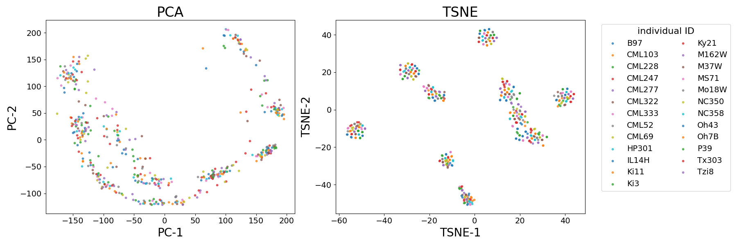
PCA and tSNE
tSNE - t-distributed stochastic neighbor embedding,
nonlinear dimensionality reduction.

Slide 5
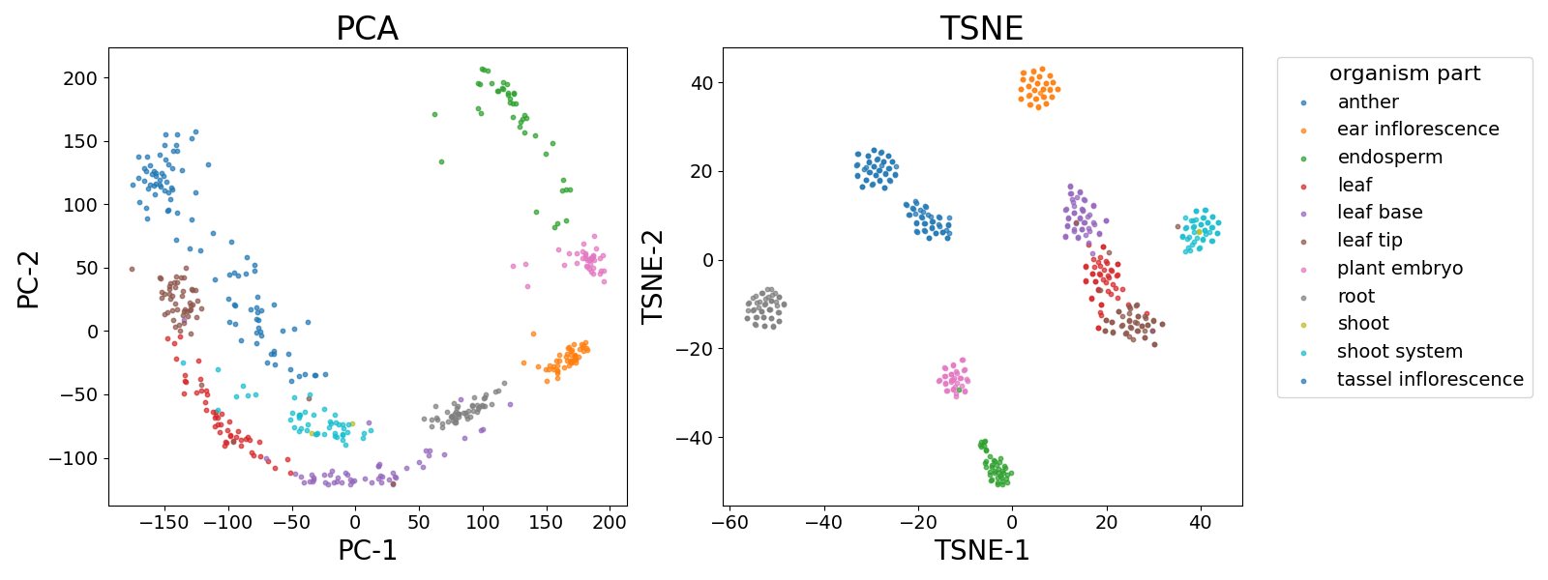
PCA and tSNE
tSNE - t-distributed stochastic neighbor embedding,
nonlinear dimensionality reduction.

Slide 6
Initial Network EDA
0.83
0.92
Unweighted
vs
Weighted
0.4
0.1
0.8
0.4
0.98
0.3
0.3
0.83
0.92
-0.83
0.92
Unsigned
vs
Signed
0.4
0.4
0.1
0.8
0.1
-0.8
0.4
0.4
0.98
0.98
0.3
0.3
-0.3
0.3

Slide 7
Key Findings and Directions
Distinct clusters of genetic expression profiles separated based on organism parts
1
Using individual / cultivar / natural variation difference to approximate perturbation
2
Investigate whether there are superficial relations that can be uncovered by regressions.
3
Explore more complex models and the possibility of transfer learning between human dataset and maize dataset
3

Slide 8
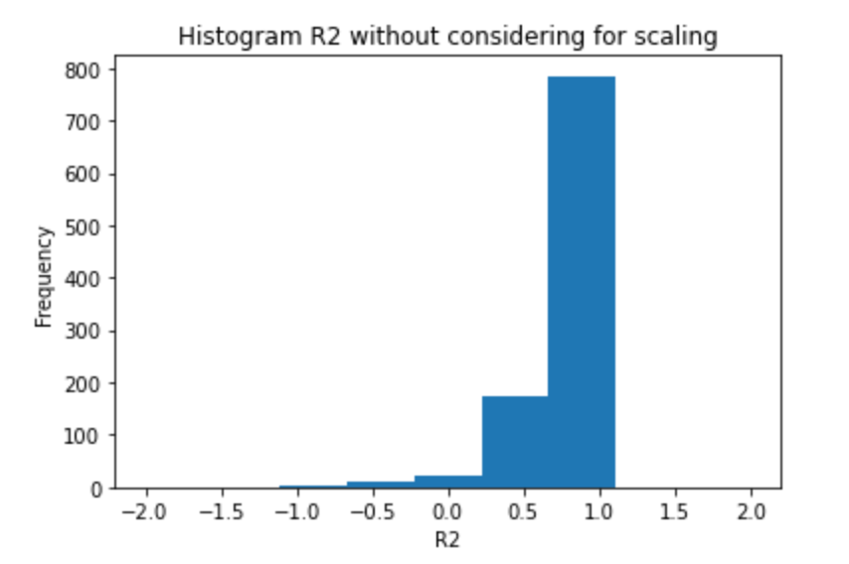
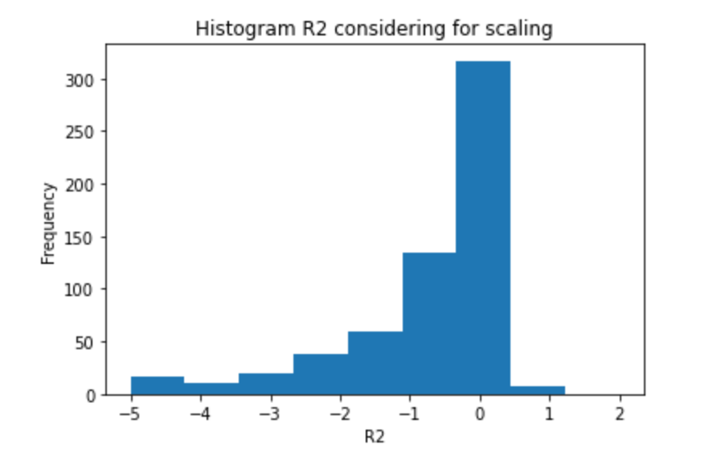
Regression as a baseline approach
Objective: Using the 1000 most expressive genes, predict the following 1000 using linear regression
Two ways of sorting:
Using the average of expression across all samples
Getting both the standard deviation and average of expressions across all samples per gene, dividing and then sorting

Slide 9
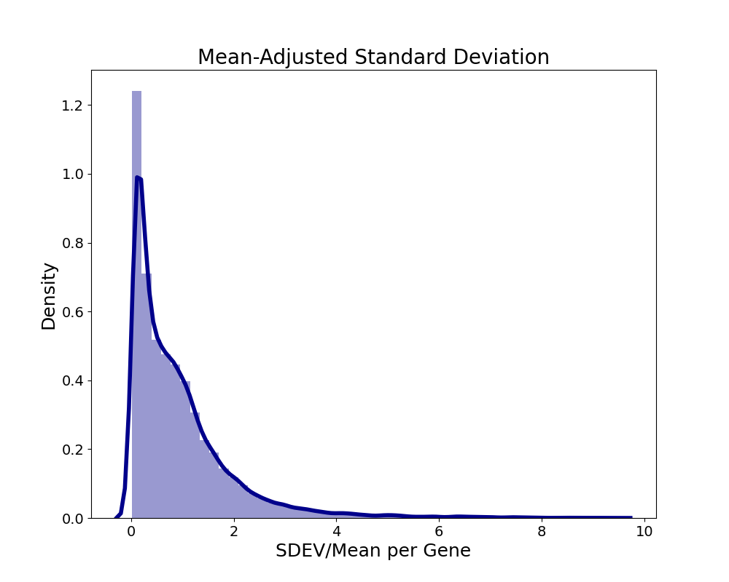
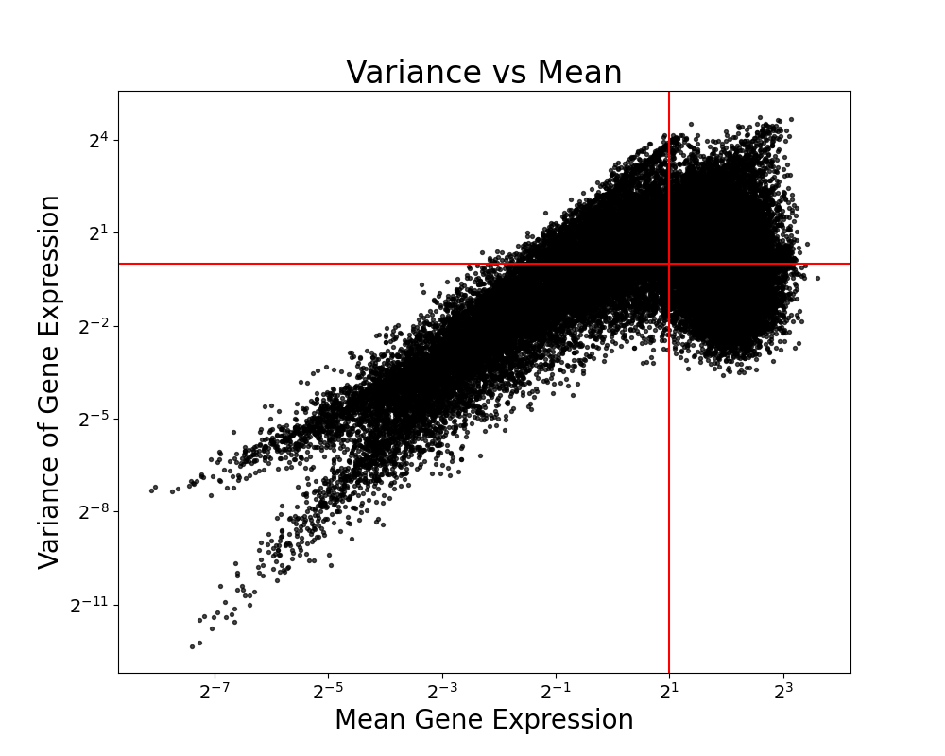
What remains difficult about the problem

Slide 10
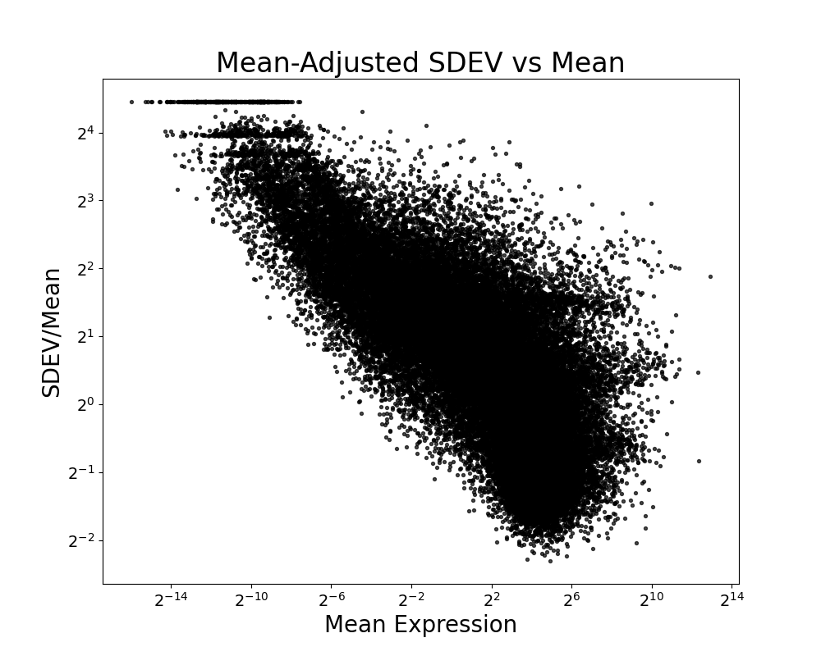
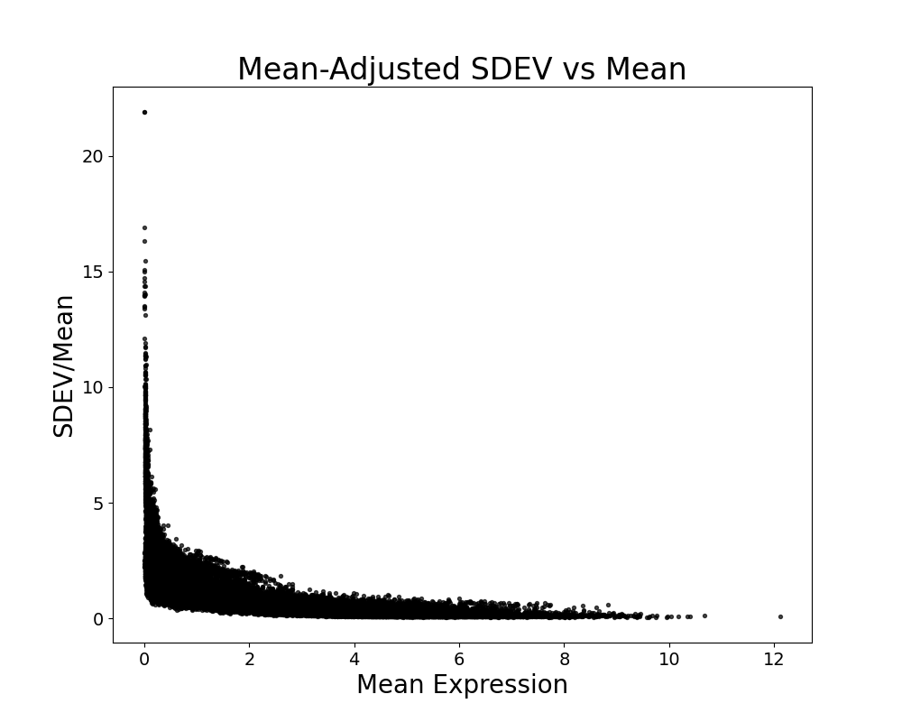
What remains difficult about the problem (Eagon)

Slide 11
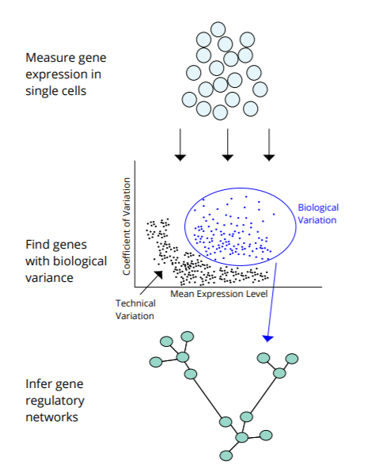
What remains difficult about the problem

Slide 12
What remains difficult about the problem

Slide 13
What remains difficult about the problem

Slide 14
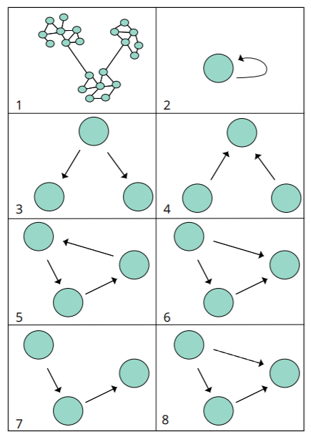
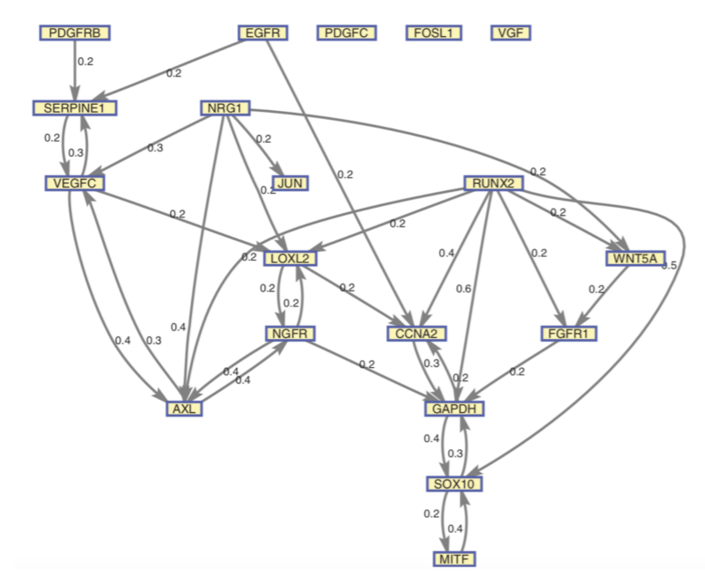
Ideal Output

Slide 15
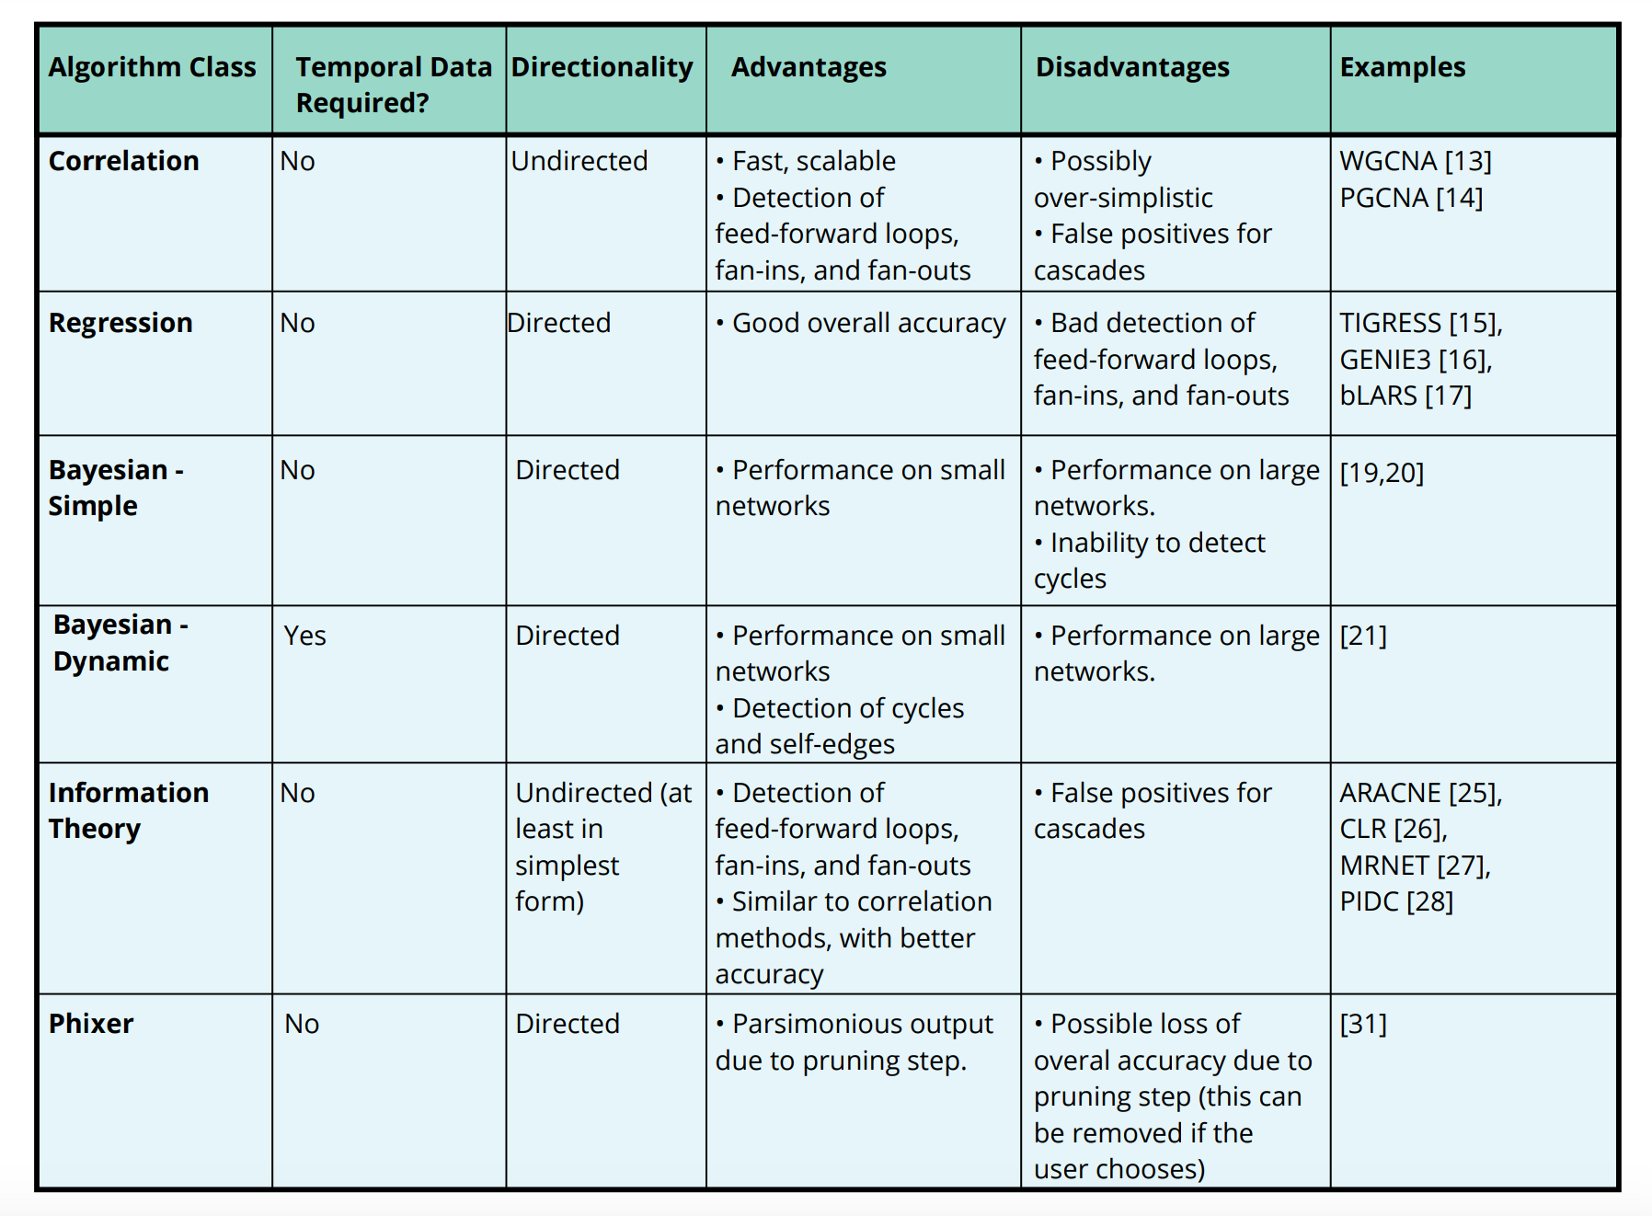
List of Potential Methods and Considerations

Slide 16

Thank You!

